Slide 1
UNIT 1
Introduction to CyberPatriot and Cybersecurity

Slide 2
Learning Objectives
Understanding of the CyberPatriot competition.
  Overview
  National Finals Competition
  Team Structure
  Scoring
  Timeline
Broad understanding of cybersecurity and its importance in everyday life
  Cybersecurity in Everyday Life
  Cybersecurity in the World
  Cybersecurity Careers

Slide 3
UNIT 1 - SECTION 1
The National Youth Cyber Defense Competition

Slide 4
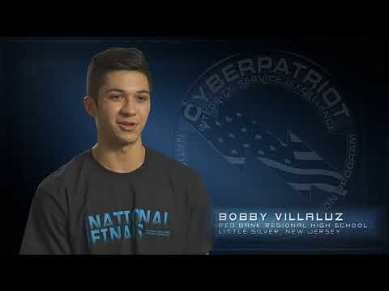
What is CyberPatriot?
Click URL to play CyberPatriot recruitment video: https://www.youtube.com/watch?v=sesaiofAEWA

Slide 5
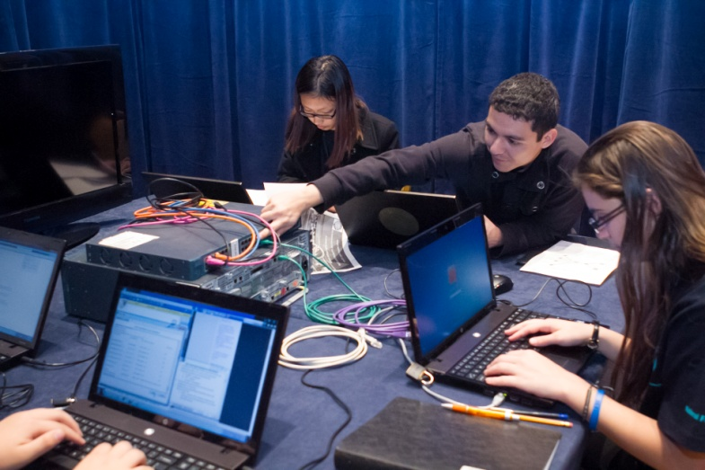
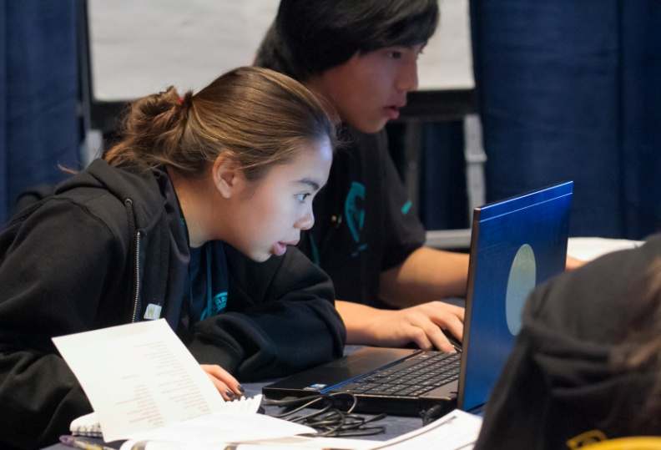
What is CyberPatriot?
The National Youth Cyber Education Program
  National youth Cyber Defense Competition
  AFA CyberCamps
  Elementary School Cyber Education Initiative
  Cyber Education Literature Series
  Cyber Generations – Senior Citizens Cyber Safety Initiative
  Tech Caregiver Program
Not hacker training
  Offensive behavior is not allowed
Fun way to learn useful skills
  Technical skills
  Teamwork
  Critical thinking

Slide 6




The National Youth Cyber Defense Competition
Registration
Coach registers team(s)
Training & Competition
10 online training modules
3+ online competition rounds
Scoring & Advancement
2-6 students per team
Scored on remediation of cyber vulnerabilities and knowledge of secure networking.
Top teams advance to Semifinals and National Finals
Optional technical mentor

Slide 7
Team Structure
Coaches are the administrative lead of the team
  Supervise students
  Are the main point of contact for CyberPatriot Program Office
  Ensure integrity of the competition
  Train teams for competition (if technically savvy)
Technical Mentors volunteer to help Coaches train teams
  Use industry expertise to teach students about cybersecurity
  Guest lecture or work with team(s) on a regular basis
Team Assistants volunteer to provide non-technical support and encouragement to the team
Competitors work together to find and fix vulnerabilities in a simulated computer system and build secure virtual networks

Slide 8
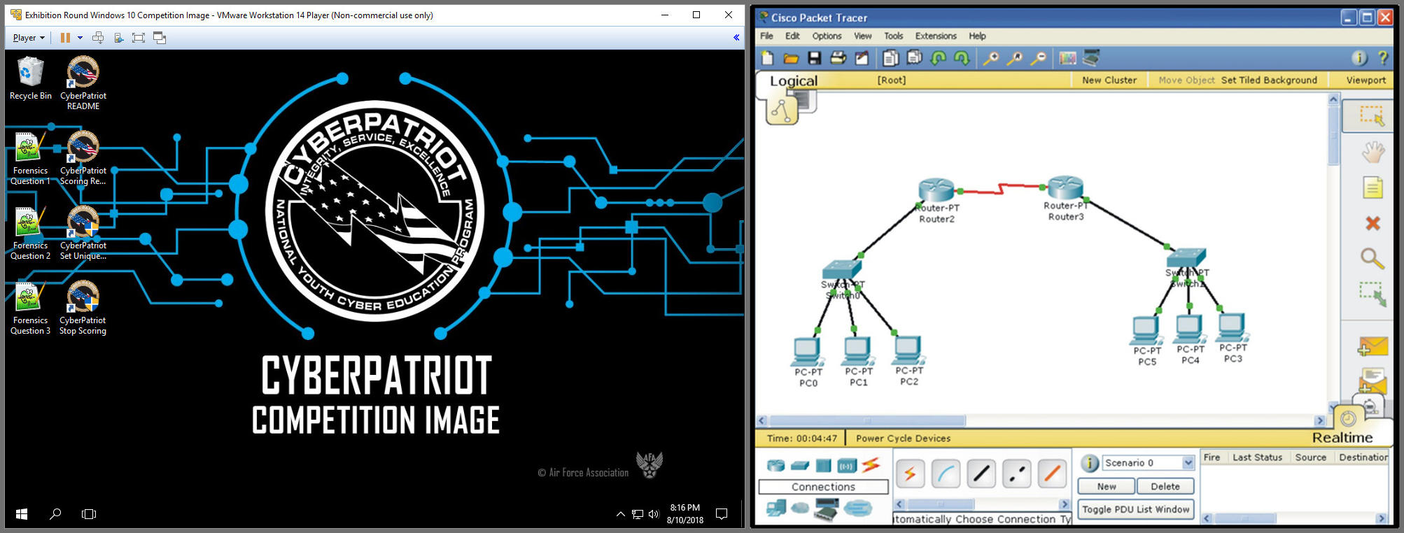
Scoring
Earn points by fixing vulnerabilities in a virtual machine (VM*), answering forensic questions, networking quiz questions and building secure virtual networks
  Virtual machines (aka “images”) are software
  programs that simulate computer systems
  Short quizzes are based on assigned materials
  Virtual networks are built with
  Cisco’s Packet Tracer program
Lose points for making the system less secure
* More information on VMs is available in Unit Five of these training materials

Slide 9
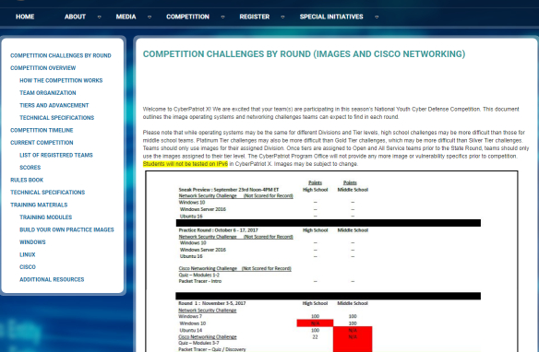
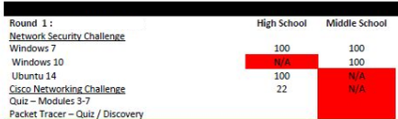
Train and Prepare
READ scheduled competition round challenges on CyberPatriot website
TRAIN with training materials, operating systems, and Cisco Networking assignments prior to rounds
PARTICIPATE in the unscored rounds
- Exhibition Rounds
- Training Rounds (answer keys provided)
- Practice Rounds
PREPARE hardware, software, and network for competition to technical specifications on CyberPatriot website
DOWNLOAD password-protected competition images from links in the download instructions email

Slide 10
Competing
EXTRACT and open images with password provided in StartEx email
IDENTIFY team with Unique ID
FIX Harden your system and defend against outside attacks by starting with hints and the scenario in the ReadMe file on the desktop (Score, Compare, Login, Open, Ask)
Not all vulnerabilities are scored or hinted at in the ReadMe
  The goal of the competition is to harden the system as completely as possible in the provided time
  You might do something that improves the system, but does not earn your team points

Slide 11
Scoring – How to Score
Prepare – read scheduled competition round challenges on CyberPatriot Website
Study operating systems and Cisco Networking assignments
Harden your system and defend against outside attacks by starting with hints and the scenario in the ReadMe file on the desktop
Not all vulnerabilities are scored or hinted at in the ReadMe
  The goal of the competition is to harden the system as completely as possible in the provided time
  You might do something that improves the system, but does not earn your team points

Slide 12
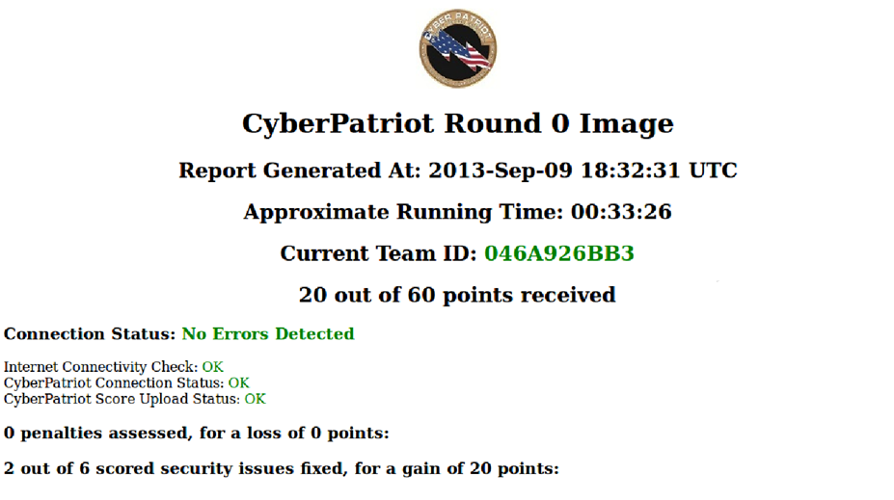
CyberPatriot Competition System (CCS)
The CyberPatriot Competition System (CCS) automatically transmits your team’s progress in the competition image (VM) to the CyberPatriot scoring server
Use the CyberPatriot Scoring Report to check your score and your connection status
A chime will play when you gain points and a buzzer will sound when you lose points
Do not open, modify, or delete anything in the “CyberPatriot” folder of any image
  Doing so could cause you to lose your progress in the image

Slide 13
Competition Deployment
SAMPLE SCHEDULE:
Sunday | Monday | Tuesday | Wednesday | Thursday | Friday | Saturday
 |  | 1 | 2 | 3 | 4 | 5
6 | 7 | 8 | 9 | 10 | 11 | 12
13 | 14 | 15 | 16 | 17 | 18 | 19
20 | 21 | 22 | 23 | 24 | 25 | 26
27 | 28 | 29 | 30 | 1 | 2 | 3
StartEx Email sent
Image Download and Instructions Email sent
COMPETITION
ROUND
Round Results Email sent
Competition emails are only sent to registered Coaches
Image Download and Instructions email includes download links and thorough instructions for the round.
StartEx email contains password to unzip images and log into user account.
Teams choose a six-consecutive-hour window during the competition weekend to compete. Six-hours must fall between support times posted by CPOC.
Later rounds have a Preliminary Results email sent to Coaches for review prior to general score release

Slide 14
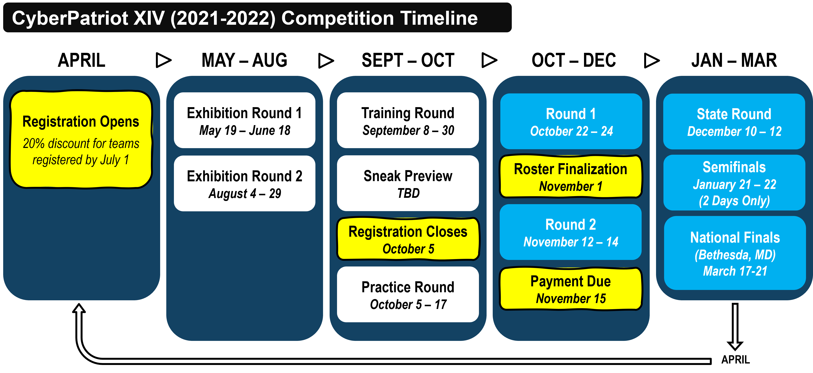
CyberPatriot Example Timeline

Slide 15
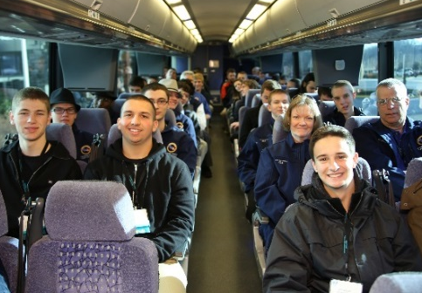
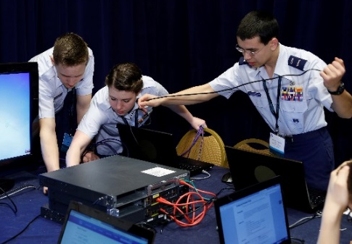
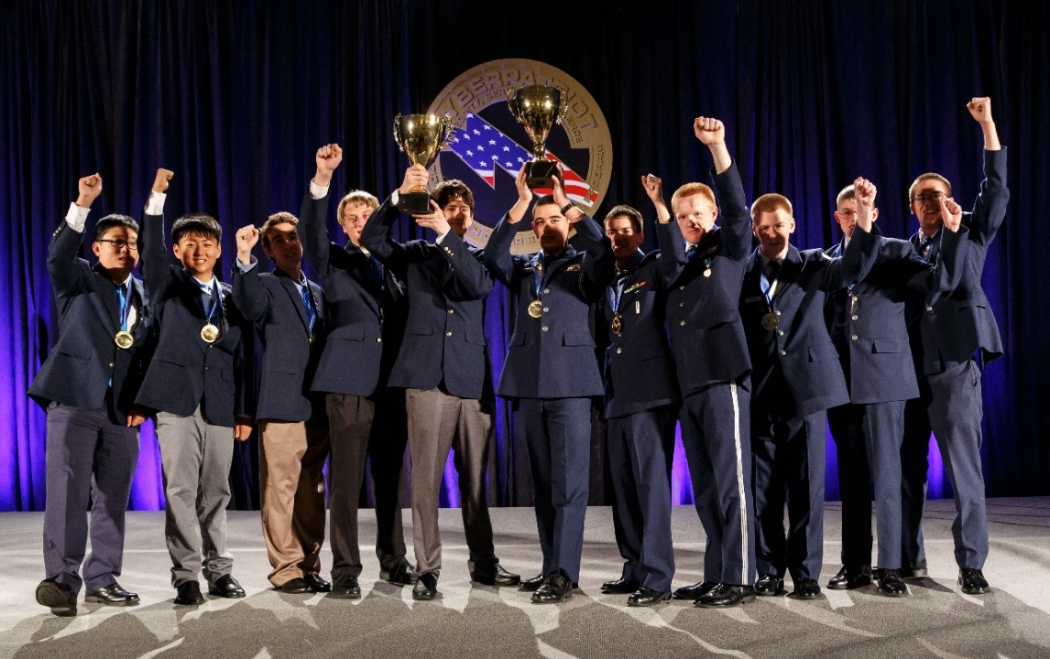
The National Finals Competition
Top teams earn all-expenses-paid trips to the District of Columbia metropolitan area
More than just competing in front of a computer
  National Finals includes the Network Security Master Challenge, Cisco Networking Challenge, an AT&T Component and other additional components
Opportunity to win scholarships, network with industry leaders, and enjoy media recognition

Slide 16
UNIT 1 - SECTION 2
Introduction to Cybersecurity

Slide 17

What is Cybersecurity?
All the tools we use and actions we take to keep computers, networks, and information safe and available for those who need it, and unavailable for those who should not have it.
That means protecting hardware
and data from everything from
hacktivists to earthquakes.
Source: www.UMUC.edu

Slide 18
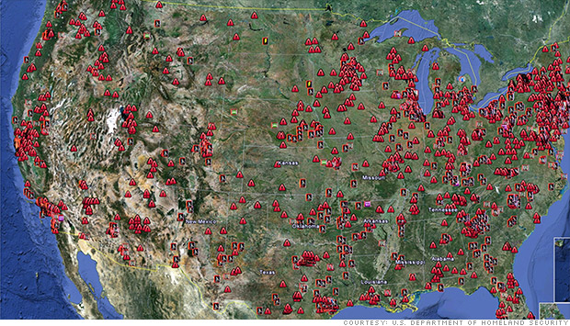
Why is Cybersecurity Important?
  Banks
  Social Media
  Schools
  Airlines and Railroads
  Stores
  Police and fire departments
  Military and government systems
  Doctors’ offices
Source: US Department of Homeland Security
7,200+ critical American industrial control systems are linked to the Internet, and therefore vulnerable to attack
Cybersecurity isn’t just about protecting computers.
Almost everything relies on or could be affected by a computer.

Slide 19
Why is Cybersecurity Important?
There are 16 Critical Infrastructure Sectors whose assets, systems, and networks are deemed so essential that if compromised or destroyed there would be existential effects on national security, national economics, and/or public health.
  Cybersecurity & Infrastructure Security Agency (CISA) listed the following as Critical Infrastructure Sectors:
  Chemical Sector
  Commercial Facilities Sector
  Communications Sector
  Critical Manufacturing Sector
  Dams Sector
  Defense Industrial Sector
  Emergency Services Sector
  Energy Sector
  Financial Services Sector
  Food and Agriculture Sector
  Government Facilities Sector
  Healthcare and Public Health Sector
  Information Technology Sector
  Nuclear Reactors, Materials and Waste Sector
  Transportation Systems Sector
  Water and Wastewater Systems Sector
Source: https://www.cisa.gov/critical-infrastructure-sectors

Slide 20
Why is Cybersecurity Important?
2006: 26.5 million veterans’ personal information is compromised after the theft of a Veteran Affairs employee’s laptop. The employee thought it was safe to bring home VA records on an unsecure drive.
2009: Coca-Cola executive clicks link in spoof email allowing attackers to steal confidential files on $2.4 billion business deal with Chinese juice company.
2011: DHS plants USB drives and CDs outside of government and government contractor buildings. The majority are picked up by employees and inserted directly into their organization’s computers.
2021: One of the United States Critical Infrastructures was compromised, the Colonial Pipeline breach. The pipeline was used to carry gasoline and jet fuel to the Southeastern U.S. Colonial Pipeline suffered from a ransomware attack that compromised computers and equipment that managed the pipeline.
People make mistakes, as noted in the 2011 incident. Cyber education is the best way to combat such incidents. Cybersecurity is often about protecting organizations and individuals from themselves.
Sources: CSO magazine, www.csoonline.com, Bloomberg News, www.bloomberg.com, GCN Magazine, www.gcn.com, NY Times, nytimes.com

Slide 21
Why is Cybersecurity Important?
Case: Backoff Malware Attacks targeted cash registers and payment systems sold by seven different companies
  Impacted major retail companies like Target, Dairy Queen, and UPS
Hackers use brute force password cracking to remotely access and infect the networks of major cash register system providers
Hackers are able to download credit card information when shoppers swipe their cards at cash registers purchased from the infected companies
Department of Homeland Security announces that the payment systems of more the 1,000 American stores may be infected
We’re all connected.
A weakness in one system can be exploited by attackers to target another system.
  Source: New York Times, http://bits.blogs.nytimes.com/2014/08/22/secret-service-warns-1000-businesses-on-hack-that-affected-target/

Slide 22









Who’s Hiring?
    Nearly every organization needs cybersecurity professionals
    Cybersecurity jobs are better paid than computer jobs in general. In 2018 the average computer job paid ~$90,000. People in cybersecurity-specific jobs earned an average salary of over $100,000.
          Source: Computer World, http://www.computerworld.com/s/article/9237394/Demand_for_IT_security_experts_outstrips_supply?pageNumber=2

Slide 23
Cyber Career Opportunities
1. Security Software Developer: software is often not built with security in mind. The Security Software Developer designs and integrates security into every aspect of the software development lifecycle.
2. Security Architect Career Path: Create and build secure networks and computers for complex security frameworks. This is an ideal career path for the problem solver who enjoys solving puzzles.
3. Security Consultant: Experts that evaluate cybersecurity threats, risks and problems to guide organizations in providing protection solutions. This is a very tech-savvy position.
4. Information Security Analyst: Professionals that stand at the front line of defense for networks. They create and maintain firewalls and monitor network activities.
5. Ethical Hacker: Are licensed professionals that try to hack a network with permission to find vulnerabilities. The try to find what is vulnerable and could be exploited by a malicious hacker.
6. Computer Forensics Analyst: Professionals that focus on cyber crimes and partake in data recovery, intercepting data linked to crimes, and a detailed look into data trails.
7. Chief Information Security Officer: Mid Executive position that oversees an organization’s IT department. They are responsible for planning, managing, and directing all computer, network and data security needs.
8. Penetration Tester: Highly skilled professionals that are typically ethical hackers and try to infiltrate a corporation's security measures (physical and electronic) with permission from the corporation. A penetration tester will use social engineering tactics to test the security of a company's employee practices.
9. IT Security Consultant: Are typically outsourced contractors that advise organizations on cybersecurity objectives. They typically service smaller businesses on tighter budgets.
10. Security Systems Administrator: The person in charge of daily operations for security controls ( installing, administering, maintaining, and troubleshooting) to include backing up data, network monitoring, user account management, and general security needs.
Source: https://medium.com/@coderacademy/10-careers-in-cyber-security-you-should-consider-2613061a8cb2
Notes:
11

Slide 24
Important Resources
These training materials are only intended to provide basic training for the competition. Coaches and Mentors can be great resources, but the below links may help as well:
The CyberPatriot Rules Book
  Click here: http://www.uscyberpatriot.org/competition/rules-book
Additional Windows resources
  Click here: http://www.uscyberpatriot.org/competition/training-materials/windows
Additional Linux resources
  Click here: http://www.uscyberpatriot.org/competition/training-materials/linux
Ubuntu practice images and Windows scoring engine provided by Texas A&M Corpus Christi
  Click here: http://www.uscyberpatriot.org/competition/training-materials/practice-images
Cisco Networking Academy available to (CyberPatriot program participants)
  Click here: https://www.uscyberpatriot.org/Pages/Announcements/Cisco_Netacad_Courses.aspx

